Slide 1

Lightweight Solutions for Detecting De-authentication Attacks
COMP 4203: Course Project
By: Matthew Nitschke && steven Rhodes

Slide 2

Presentation Overview
Domain Description
Research Question
Technology
Outline of Study Methodology

Slide 3

Domain Description
Course Topic: Wireless Network Security
Critical to have secure and safe systems for wireless networks
Focus on IEEE 802.11 security, specifically, security around the sending of de-authentication/disassociation frames between a client and the access point (AP)

Slide 4

Research Question
De-authentication frames are sent between clients and the AP to terminate connection
Frames are both unencrypted and not authenticated
Problem: as an attacker it is easy to spoof de-authentication frames, allowing for Denial of Service (DOS) attacks
Question: how to detect de-authentication attacks when they occur?

Slide 5

Technology
Python (for client, server, and attack simulation)
Window, Linux (maybe Kali)
PyShark (for monitoring wireless packets)
Other Web Technologies: Wireshark, tcpdump (for network monitoring)

Slide 6

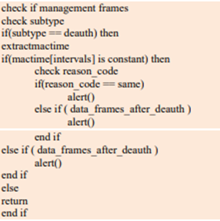
Outline of Study Methodology
Develop a simulation for research paper #1 (see last slide) => A Lightweight Solution for Detecting De-authentication Attack
Send frames Monitor traffic between our client and server (Python, WireShark, tcpdump)
Check for the de-authentication subtype of management frames
Check whether MAC timestamp is constant and reason codes are same: sound alert in appropriate situation

Slide 7
Outline of Study Methodology – Part 2
Once the simulation detects that an attack has occurred properly, we can make a comparison between research paper 1 and 2
Determine which achieves the research question best.
Write final report outline the recommendation

Slide 8
Thank you for listening!
Research Papers:
Paper 1: A Lightweight Solution for Detecting De-authentication Attack
https://aircconline.com/ijnsa/V11N1/11119ijnsa02.pdf
Paper 2: A Lightweight Solution for Defending Against De-authentication/Disassociation Attacks on 802.11 Networks.
https://www.researchgate.net/publication/221092095_A_Lightweight_Solution_for_Defending_Against_DeauthenticationDisassociation_Attacks_on_80211_Networks
THE END!

